Slide 1
Banking Management System
An efficient way to maintain all accounts and transactions processed
in a Bank

Slide 2
INTRODUCTION
The “Banking Management System” project is a model Internet Banking Desktop Application. This application enables its customers to perform the basic banking transactions by sitting at their office or at homes through PC or laptop. The system provides access to customers to create an account, deposit/withdraw the cash from his account, transfer money to another account and also to view reports of all accounts present. Customers can access the banks application for viewing their Account details and perform transactions on account as per their requirements. With Internet Banking, the brick and mortar structure of the traditional banking gets converted into a click and portal model, thereby giving a concept of virtual banking a real shape. Thus today's banking is no longer confined to branches. E-banking facilitates banking transactions by customers round the clock globally.

Slide 3
Features
Detailed Account Statement
Security
Verification
Entire Customer List
Transfer, Withdraw and Deposit Money
User friendly Interface
Change security Pin

Slide 4
System Architecture
Update User Details
Login or Register
View Profile and account details
Application
User
JAVA
SQLite
Front-end:
Deposit, Transfer and Withdraw money
Back-end:

Slide 5
Advantages
Disadvantages
The application delivers an efficient user interface design, as all the key elements are taken care of during the designing of the system.
It is an open-source application and available to all users irrespective of their operating system.
The Banking management system provide high authenticity for account holders
The Banking Management System is restricted to Desktop users only and the Desktop machine must have Java JRE preinstalled
SQLite is implemented, which is used to handle low to medium traffic HTTP requests and database size is restricted to 2GB in most cases
All the transactions are maintained inside a database at an offline level. For each transaction the database needs to be updated specifically

Slide 6
Applications
Personal Banking
Banking Management System can be used for keeping a record of personal banking transaction statements.
Organizations
Banking Management System can also implemented at an organizational level such as NGOs, private institutes.

Slide 7
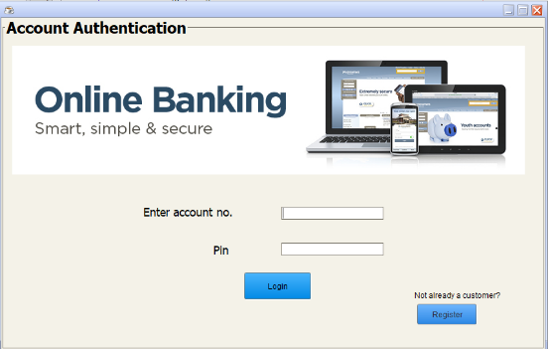
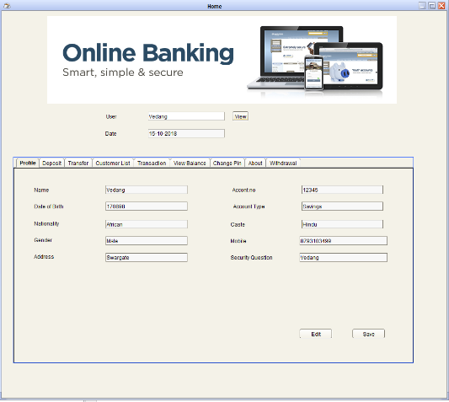
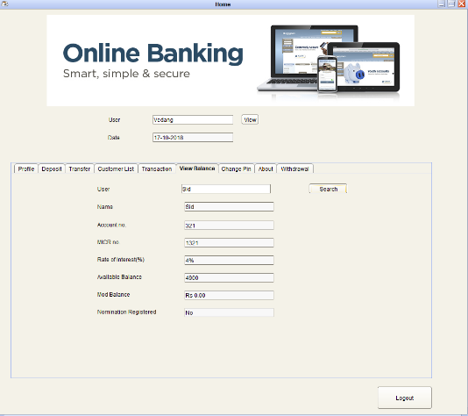
Overview
Authentication
Register new account
Account statement

Slide 8
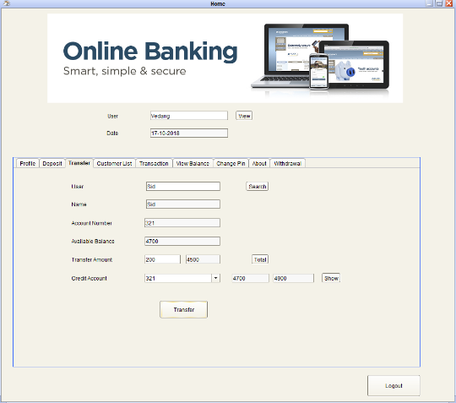
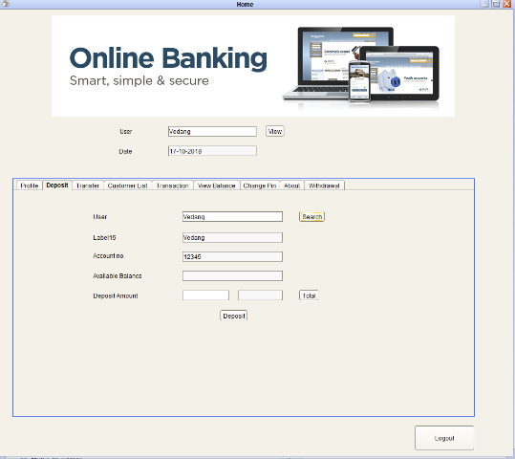
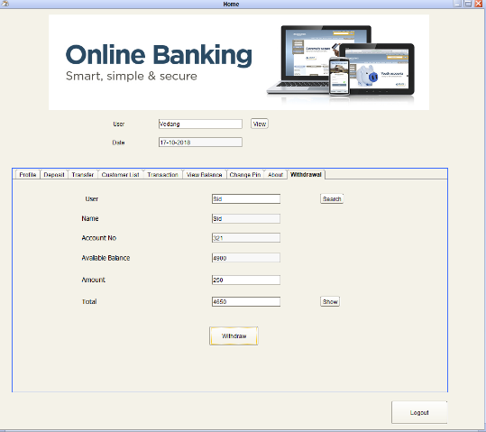
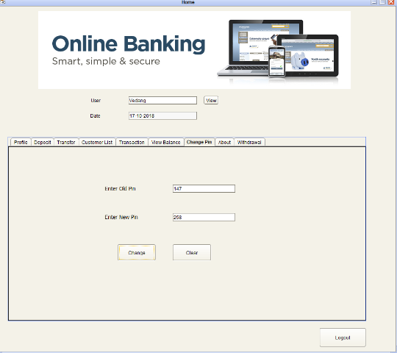
Transfer
Deposit
Withdrawal
Change security pin

Slide 9

Developers
THANK
YOU
Skills Development Lab (310246)
Vedang Wartikar TC172
Siddharth Yawatkar TC173
Arnav Rokde TC159
The project can be found at:
https://github.com/vedangwartikar/bank-mgmt-sys

